Slide 1
Report of research
Based on the research on COVID-19 pandemic

Slide 2
Research aims
To simulate the government policy transformation to the COVID-19 pandemic by python program
Using the program built from the simulation to predict new pandemic like MonkeyPox which can be referenced by scholar and government

Slide 3
Research objects
Government policies: there are 2 main policy combinations of a government to take (NPI): the aggressive policy (dynamic zero in China) and herd immunity.
Virus, its influence can be represented as infected population.

Slide 4
Policies
Different policies will cause decreasing or increasing on the number of infected population and also bring different economic costs.
The fitness function is the core feature of different policy combinations. For example, if the policy taken now in the Chinese style is dynamic zero and the economic costs is really high then the next policy will still be dynamic zero. However, if the policy taken now in the Western style is dynamic zero and the economic costs is also high then the government will choose herd immunity.

Slide 5
Chinese Mode and “Western” MODE
Tracker of the policy change
https://www.imf.org/en/Topics/imf-and-covid19/Policy-Responses-to-COVID-19#T
The UK policy changes from Laissez-faire at the beginning of the COVID-19, to the herd immunity in response to the initial outbreak, and then turn into the Laissez-faire policy again in order to reopen the economy.
Chinese policies is simple, before noticing the spreading of the COVID-19, the policy is Laissez-faire. However, after noticing the rapid spreading of the COVID-19, the policy changed to aggressive policy immediately and have not changed until now.

Slide 6
The SIMULATION process-1
Actually, the simulation of my project is not so close to the typical GA. The typical GA will generate many (200 or more) population of the dataset to indicate the initial genes, actually, in the research of Oxford student gives a GA which will generate so many different combinations of policies as the basic genes for evolution.
However, in my simulation, the policies are simple which are just the 2 main policies described before.

Slide 7
The SIMULATION process-2 Basic Concepts and IDEA
Initialization. Before actually doing the simulation, many parameters has to be initialized: the initial infected population = 1; the initial policy available = laissez-faire, herd immunity and aggressive; the fitness function of both Chinese mode and UK mode is set; the R0 value of COVID-19 is set, etc.
After setting these parameters, the simulation will be running. The infected people will spread his/her virus to others based on the R0 value. Based on the current infected population, the government will choose different policies based on the fitness function. If it is herd immunity or aggressive, then those infected people will be isolated and the policy will cost money based on the infection rate.

Slide 8
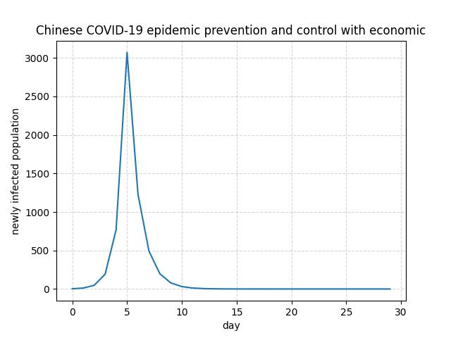
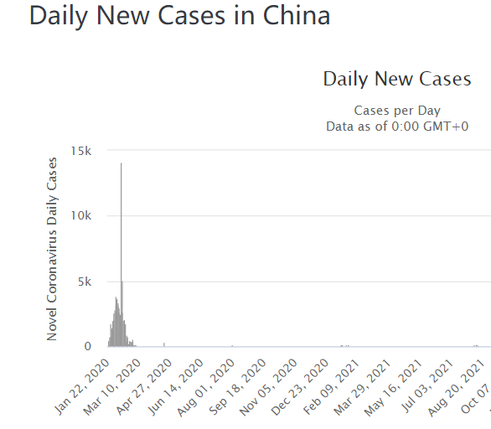
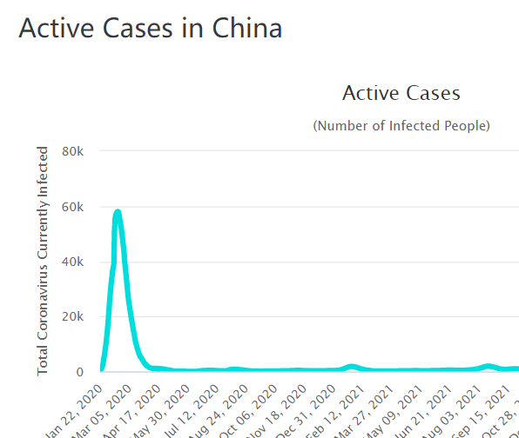
Results-CHINA
Based on the aims of research, the simulation and the real data is shown below
https://www.worldometers.info/coronavirus/country/china/

Slide 9
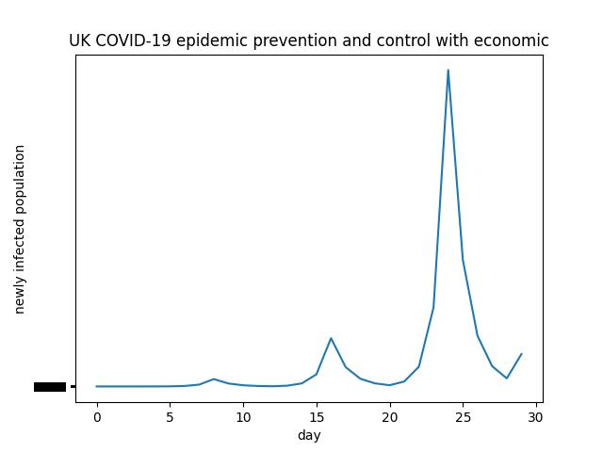
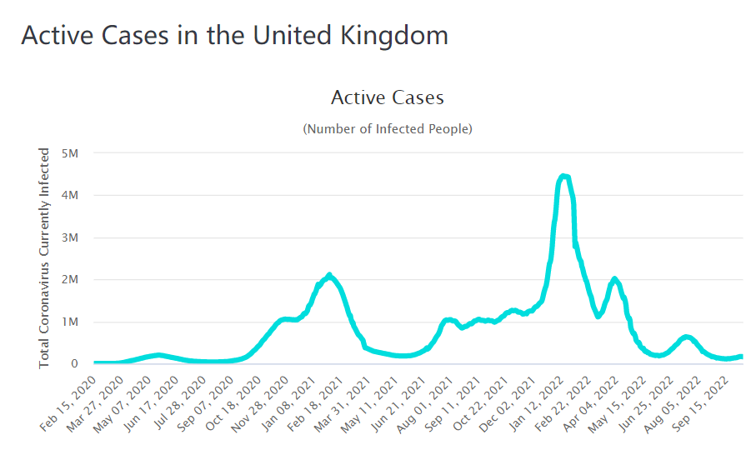
Results-UK
Based on the aims of research, the simulation and the real data is shown below
https://www.worldometers.info/coronavirus/country/china/

Slide 10
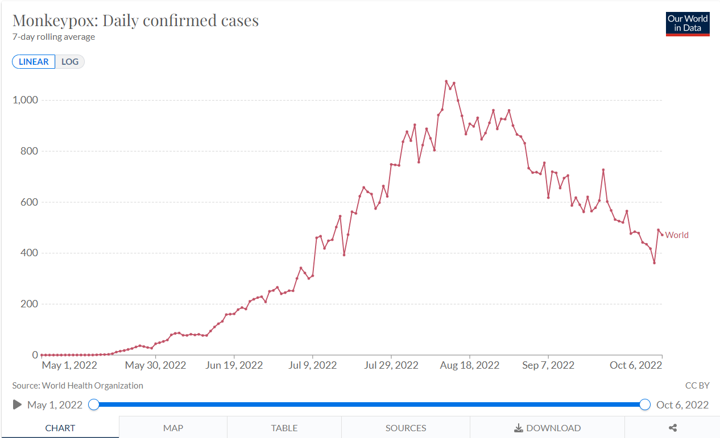
Next Tasks
To simulate the monkeypox. The research object is cases in New York city.
https://ourworldindata.org/monkeypox

Slide 11
Validation
1. Another task is using other techniques (algorithms) to validate the simulation program. For example, the predicting AI algorithm like Decision Tree.
2. However, the input cannot be easily determined. The new cases infected each day is one of the input but the economic costs data cannot be easily got as well as the policy changing.

